Slide 1
Dystopian Comparative Analysis.

Slide 2
Please Do Now -- 1/2/18
Open to page 74 in your packet -- looking at your notes on page 73, write a THESIS for your comparative literary analysis. REMEMBER: Your thesis should include a shared theme, the title and author of both texts, and the three literary elements that will be your subtopics.
Just like a hypothesis -- your thesis may change throughout the writing process.

Slide 3
Agenda 1/2/18
Complete graphic organizer -- page 74-76
Use your thesis statement to label each body paragraph (what text should it be about, what is the theme, literary element)
Find evidence from each text -- you can use past constructed responses, notes in your packet, the text, and pages from the back of your packet for independent novels.

Slide 4
Literary Elements:
Characters: Protagonist, Antagonist, Supporting Characters
Setting: Physical Setting, Temporal Setting, Social Setting in regard to culture (unwritten rules of society), Social Setting in regard to power (hierarchy)
Plot: Exposition, Rising Action, Climax, Falling Action, Resolution, Conflict and Resolution, Essential Episodes, Dialogue

Slide 5
Homework 1/2/18
Read your book -- should be finished book
Revisions to CR 2 (must be highlighted) due Thursday at 1/4/18
Writing graphic organizer due by Friday 1/5 at the beginning of class.

Slide 6
Agenda 1/3/18
Complete graphic organizer -- page 74-76
You should have a thesis statement written.
GOAL: By the end of period, have all three topic sentences written and find your four pieces of evidence.

Slide 7
Homework 1/3/18
Read your book -- should be finished book
Revisions to CR 2 (must be highlighted) due Thursday at 1/4/18
Writing graphic organizer due by Friday 1/5 at the beginning of class.

Slide 8
Agenda 1/8/18
Complete graphic organizer -- page 74-76
You should have a thesis statement written, topic sentences, and evidence.
GOAL: By the end of period, have thesis and all three body paragraphs completed.

Slide 9
Homework 1/8/18
Read your book -- should be finished book 4 (you have until the end of the unit to turn in extra credit).
Revisions to CR 2 (must be highlighted) were due by THURSDAY -- turn them in by tonight, if you haven't.
Writing graphic organizer due by tomorrow at the beginning of class.
I will check graphic organizers for creative writing (plot) that were due last Tuesday, tomorrow!

Slide 10
Agenda 1/9/18
Review introductions and conclusions
Write introductions and conclusions
GOAL: By the end of period, have hook, background information, and conclusion written

Slide 11
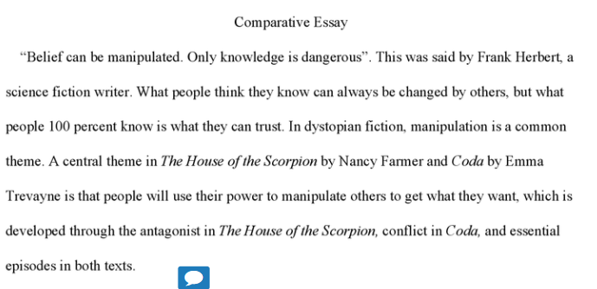

Slide 12
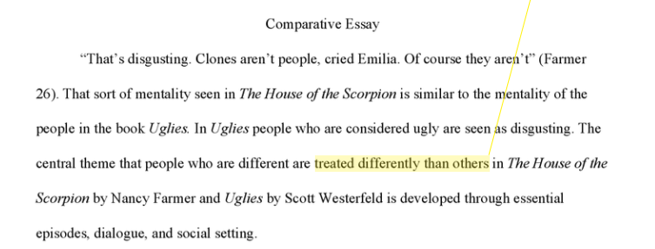

Slide 13
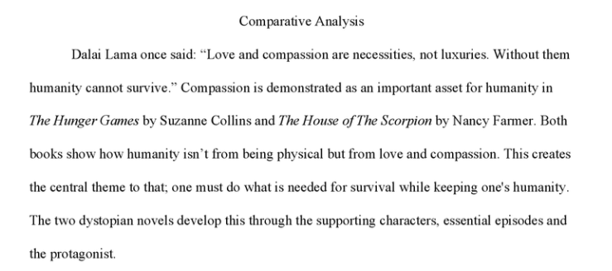

Slide 14
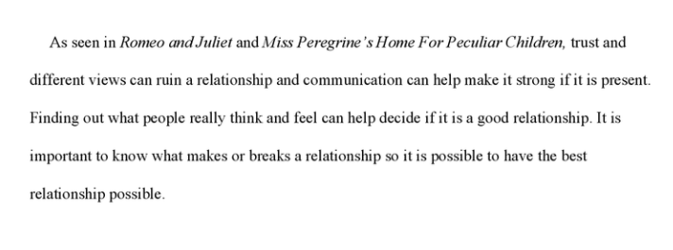

Slide 15
Homework 1/9/18
Read your book -- should be finished book 4 (you have until the end of the unit to turn in extra credit).
Introduction and conclusion graphic organizer will be checked tomorrow. (77-78)
Creative Writing (66-68)

Slide 16
Agenda 1/10/18
Start drafting
GOAL: Finish rough draft (full five paragraphs types, MLA format, Works Cited page) by Thursday at the end of class.

Slide 17
Homework 1/9/18
Read your book -- should be finished book 4 (you have until the end of the unit to turn in extra credit).
Rough Draft

